Slide 1
SALES RECORDED IN SEVERAL REGIONS
Presented by:
Muhammad Fitri bin Salim (2019314589)
Norfaizatulah binti Abdullah (2019314473)
Miftakul Huda bin Muchamad Imron (2019329007)

Slide 2
INTRODUCTION

Slide 3
Background of Study
Sale is defined as a transaction that occurs between two or more parties in which the buyer receives tangible or intangible goods, services or assets in exchange for money.
Sale is essentially a contract between the buyer and the seller of a particular good or service.
Sales can also be completed between businesses such as when one raw material provider sells available materials to a business that uses materials to produce consumer goods.
Sale transaction is recorded as a reference for business purposes in the future.
The information and details gained from each occurring sale may help company to make a better decision in generating more profit in the future.
Five variables recorded in the sale transaction which are region, item type, number of items sold, total profit and total revenue with 500 observations are used in the study.
Further study is made to determine the impact of selling different type of products and identify the profit standings for each region.

Slide 4
Research Objectives
1. To compare the differences between Asia region and Europe region towards the total revenue made.
2. To identify whether there is significant differences in total number of units sold among item types.
3. To determine the association between regions and three total profit levels.

Slide 5
Data Description
Secondary dataset obtained from http://eforexcel.com/wp/downloads-18-sample-csv-files-data-sets-for-testing-sales/
VARIABLES | DESCRIPTION | TYPE
Region | Regions in which sales had occurred | Nominal
Item_Type | The type of items sold | Nominal
Units_Sold | The total number of units sold | Numeric
Total_Revenue | The total income received from the sales | Numeric
Total_Profit | The total profit after deducting the total cost from the total revenue obtained | Numeric

Slide 6
METHODOLOGY

Slide 7
SAS Data Library
Data Management
LIBNAME libref ‘SAS-library’;
Import Data
PROC IMPORT DATAFILE= ‘external-file-name’
OUT= <libref> ‘SAS-data-set’
DBMS=’identifier’;
RUN;
SAS Data Library
DATA ‘output-SAS-data-set’;
RUN;

Slide 8
Reading Data from Existing Data Set
Data Management
DATA ‘output-SAS-data-set’;
SET ’input-SAS-data-set’;
RUN;
Selecting Variables
DATA ‘output-SAS-data-set’;
SET ’input-SAS-data-set’;
KEEP variables;
RUN;
Sub-setting Data
DATA ‘output-SAS-data-set’;
SET ’input-SAS-data-set’;
KEEP variables;
WHERE where-expression
RUN;

Slide 9
Formatting Data Values
Data Management
PROC FORMAT;
VALUE format name range1= ‘label’
range2= ‘label’;
RUN;
The Print Procedure
PROC PRINT DATA = SAS-data-set;
RUN;
Print Selected Variable
PROC PRINT DATA = SAS-data-set;
VAR variable(s);
RUN;
Defining Title
TITLE “title”;

Slide 10
Summary Statistics
Descriptive Statistics
PROC MEANS DATA = SAS-data-set;
RUN;
Summary Reports
PROC FREQ DATA = SAS-data-set;
TABLES variable1*variable2;
RUN;
Tabulate Procedure
PROC TABULATE DATA = SAS-data-set<option>;
CLASS classvariables;
VAR analysis-variables;
TABLES pageexpression;
RUN;

Slide 11
Descriptive Statistics
Bar and Pie Chart
PROC GCHART DATA= SAS-DATA-SET;
Specifying the desired type of chart:
HBAR3D chart-variable…</options>;
VBAR chart-variable…</options>;
PIE3D chart-variable…</options>;

Slide 12
Non-parametric Tests
Inferential Statistics
Test of Normality
PROC UNIVARIATE DATA = SAS-data-set;
VAR variable(s);
PROBPLOT/NORMAL (MU=EST SIGMA=EST);
RUN;
Wilcoxon Rank Sum Test (Mann-Whitney U Test)
PROC NPAR1WAY DATA = SAS-data-set WILCOXON;
CLASS variable(s);
VAR variable(s);
EXACT Wilcoxon;
RUN;

Slide 13
Non-parametric Tests
Inferential Statistics
Kruskal-Wallis Test
PROC NPAR1WAY DATA = SAS-data-set WILCOXON;
CLASS variable(s);
VAR variable(s);
RUN;
Chi-square Test
PROC FREQ DATA = SAS-data-set;
TABLES variable*variable/EXPECTED CHISQ FISHER;
RUN;

Slide 14
RESULTS AND ANALYSIS

Slide 15
Data Conversion
Converting an Excel file into SAS dataset:
proc import out = project.all
datafile = "H:\Users\Asus\Documents\Degree UiTM Seremban\PART 5\STA 610 (SAS)\Project\SalesRecords.xlsx"
dbms = excel;
run;

Slide 16
Data Management
1. Selecting 500 observations from 1000 sales record.
data project.sales;
set project.all (obs=500);
keep Region Item_Type Units_Sold Total_Revenue Total_Profit;
run;

Slide 17
Data Management
2. The new sample dataset is partitioned into several datasets named project.AE, project.items and project.regions that are related to each objective of this study that the researchers are interested in achieving.
data project.AE;
set project.sales;
keep Region Total_Revenue;
where Region in ('Asia','Europe');
run;
data project.items;
set project.sales;
keep item_type units_sold;
run;

Slide 18
Data Management
3. Classifying the total profit into three levels which are low, moderate and high for each region to be used on the third objective of this study.
proc format;
value profitfmt
low -<500000 = 'Low'
500000-<1000000 = 'Moderate'
1000000-high = 'High';
run;
data project.regions;
set project.sales;
keep region total_profit;
format total_profit profitfmt.;
run;

Slide 19
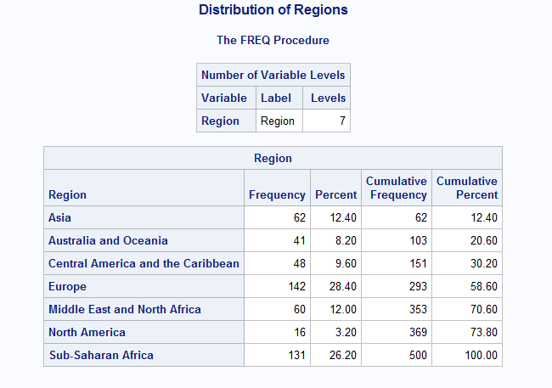
Descriptive Analysis
Frequency Report
title 'Distribution of Regions';
proc freq data=project.sales nlevels;
tables Region;
run;

Slide 20
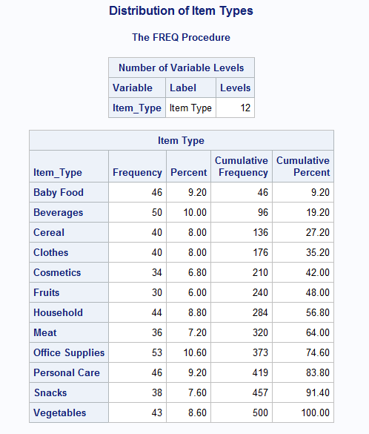
Descriptive Analysis
Frequency Report
title 'Distribution of Item Types';
proc freq data=project.sales nlevels;
tables Item_Type;
run;

Slide 21
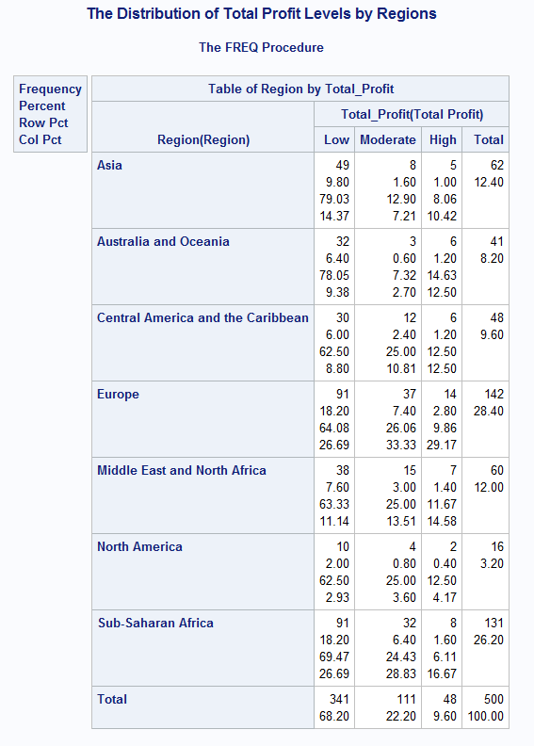
Descriptive Analysis
Frequency Report
proc format;
value profitfmt
low -<500000 = 'Low'
500000-<1000000 = 'Moderate'
1000000-high = 'High';
run;
title 'The Distribution of Total Profit Levels by Regions';
proc freq data=project.sales;
tables Region*Total_Profit;
format Total_Profit profitfmt.;
run;

Slide 22
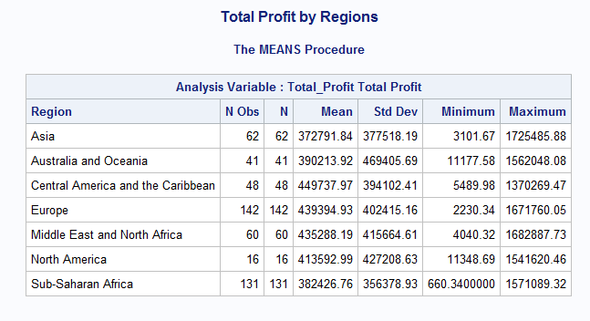
Descriptive Analysis
Summary Statistic
title 'Total Profit by Regions';
proc means data=project.sales;
var Total_Profit;
class Region;
run;

Slide 23
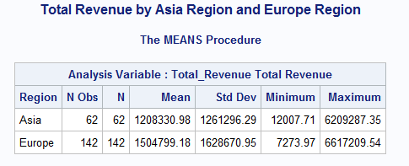
Descriptive Analysis
Summary Statistic
title ‘Total revenue by Asia Region and Europe Region’;
proc means data=project.sales maxdec = 2;
var Total_Revenue;
class Region;
where Region in (‘Asia’,’Europe’);
run;

Slide 24
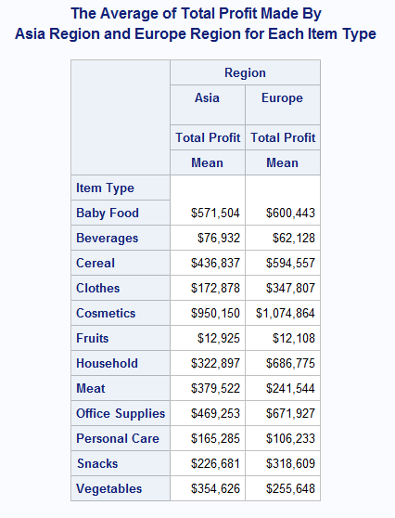
Descriptive Analysis
Summary Statistic
title1 'The Average of Total profit made by Asia Region and Europe Region';
title2 'For Each Item Type';
proc tabulate data=project.sales;
where region in ('Asia','Europe');
class region item_type;
var total_profit;
table item_type, region*total_profit;
run;

Slide 25
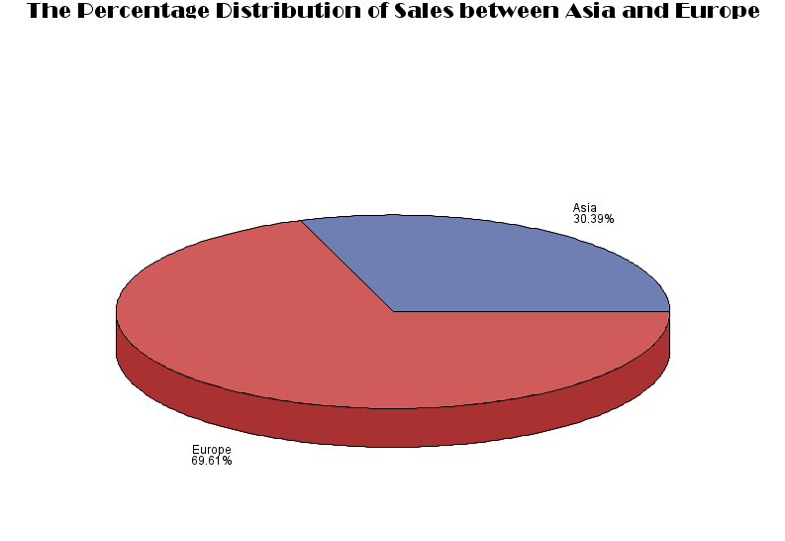
Descriptive Analysis
Pie Chart
title h=2 f=broadway 'The Percentage Distribution of Sales between Asia and Europe';
proc gchart data=project.sales;
pie3d region / type=percent noheading;
where region in ('Asia','Europe');
run;

Slide 26
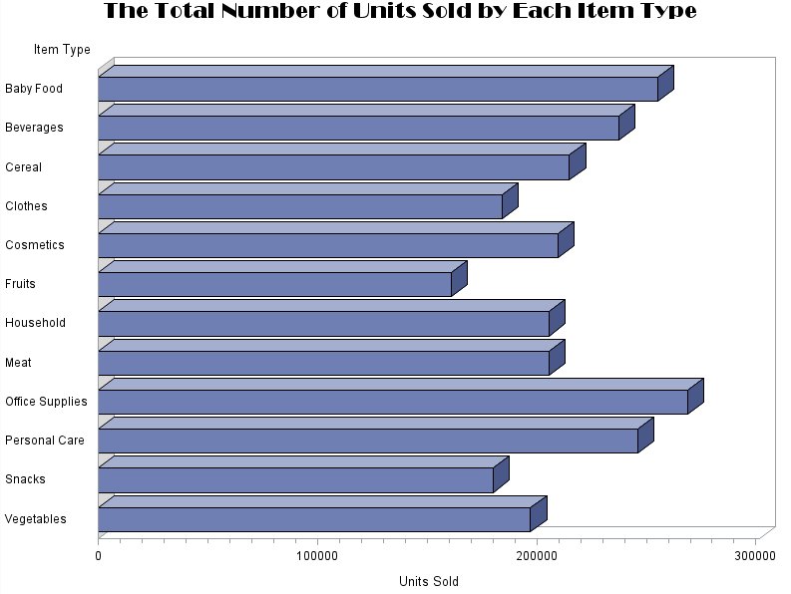
Descriptive Analysis
Horizontal Bar Chart
title h=2 f=broadway 'The Total Number of Units Sold by Each Item Type';
proc gchart data=project.sales;
hbar3d item_type / sumvar=units_sold nostats;
run;

Slide 27
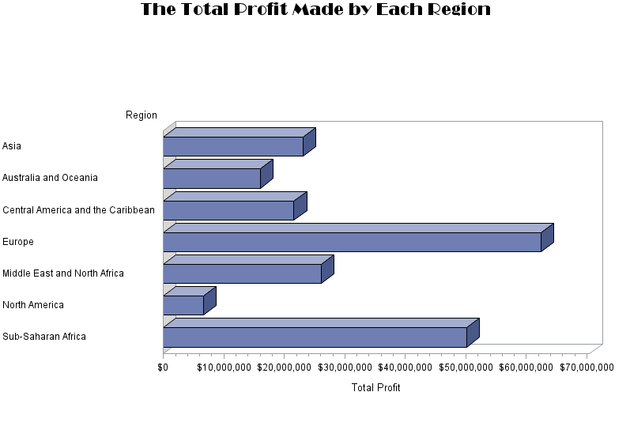
Descriptive Analysis
Horizontal Bar Chart
title h=2 f=broadway 'The Total Profit Made by Each Region';
proc gchart data=project.sales;
hbar3d region / sumvar=total_profit nostats;
format total_profit dollar12.;
run;

Slide 28
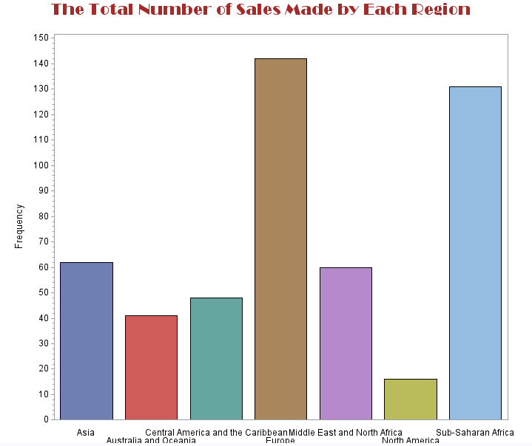
Descriptive Analysis
Vertical Bar Chart
title h=2 f=broadway c=brown 'The Total Number of Sales Made by Each Region';
axis1 stagger label=none;
axis2 label=(a=90 'Frequency');
proc gchart data=project.sales;
vbar region / patternid=midpoint width=10 maxis=axis1 raxis=axis2;
run;

Slide 29
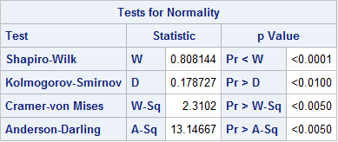
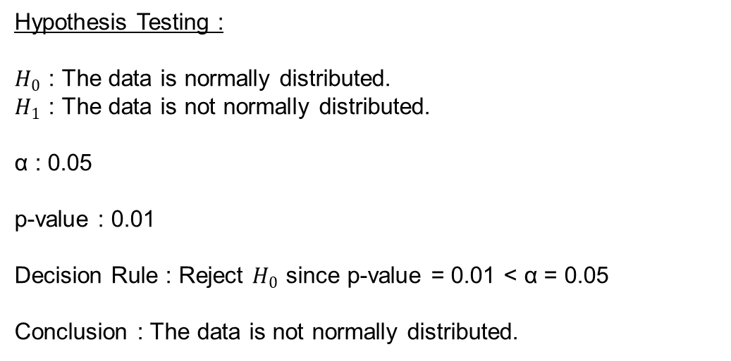
Normality Test on Total Revenue for Asia Region and Europe Region
Inferential Statistic
proc univariate data=project.AE normal;
var total_revenue;
probplot / normal (mu=est sigma=est);
run;
Hypothesis Testing :
$H_{0}$ : The data is normally distributed.
$H_{1}$ : The data is not normally distributed.
α : 0.05
p-value : 0.01
Decision Rule : Reject $H_{0}$ since p-value = 0.01 < α = 0.05
Conclusion : The data is not normally distributed.

Slide 30
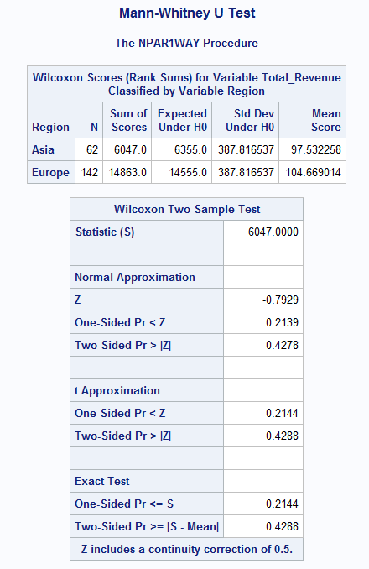
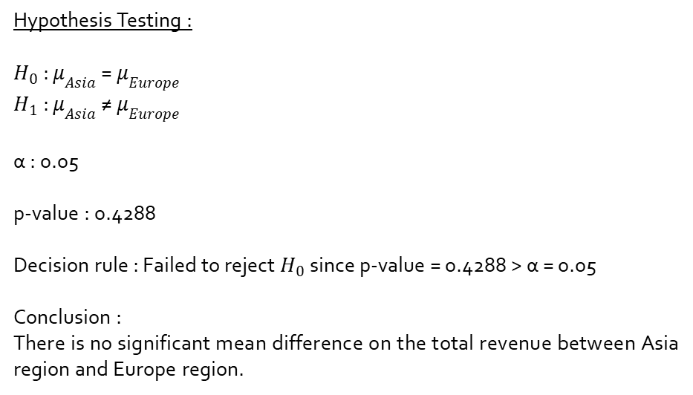
Mann-Whitney U Test to Compare the Differences Between Asia Region and Europe Region on Total Revenue
Inferential Statistic
title 'Mann_Whitney U Test';
proc npar1way data=project.AE wilcoxon;
class region;
var total_revenue;
exact Wilcoxon;
run;
Hypothesis Testing :
$H_{0}$ : $μ_{Asia}$ = $μ_{Europe}$
$H_{1}$ : $μ_{Asia}$ ≠ $μ_{Europe}$
α : 0.05
p-value : 0.4288
Decision rule : Failed to reject $H_{0}$ since p-value = 0.4288 > α = 0.05
Conclusion :
There is no significant mean difference on the total revenue between Asia region and Europe region.

Slide 31
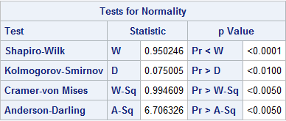
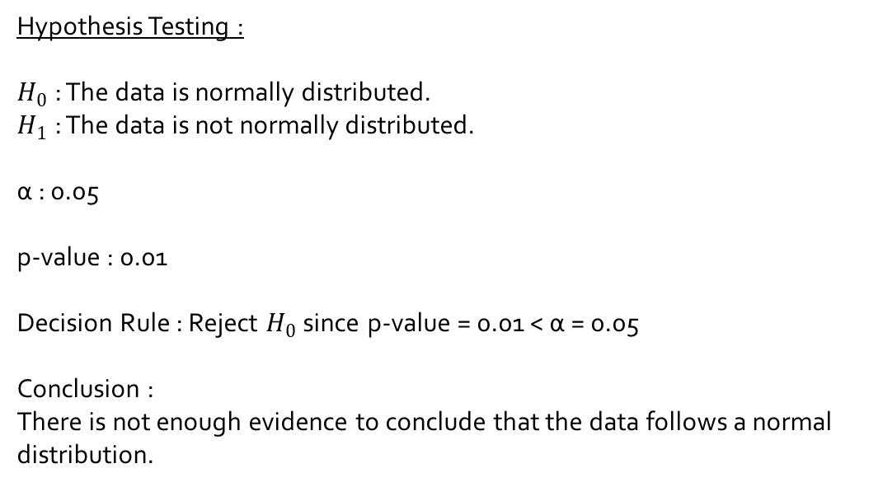
Normality Test for Number of Items Sold
Inferential Statistic
proc univariate data=project.items normal;
var units_sold;
probplot / normal (mu=est sigma=est);
run;
Hypothesis Testing :
$H_{0}$ : The data is normally distributed.
$H_{1}$ : The data is not normally distributed.
α : 0.05
p-value : 0.01
Decision Rule : Reject $H_{0}$ since p-value = 0.01 < α = 0.05
Conclusion :
There is not enough evidence to conclude that the data follows a normal distribution.

Slide 32
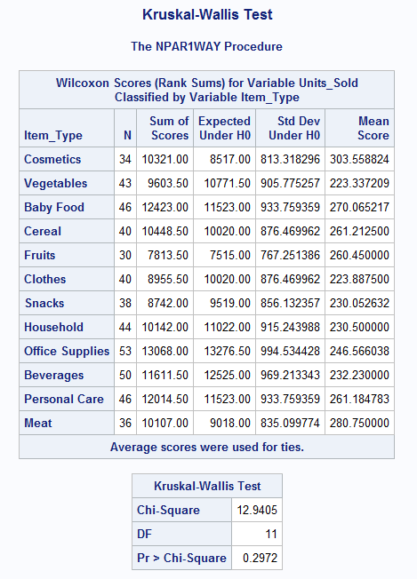
Kruskal-Wallis Test to Determine Whether There is a Significant Mean Difference in the Number of Items Sold Among Item Types
Inferential Statistic
title 'Kruskal-Wallis Test';
proc npar1way data=project.items wilcoxon;
class item_type;
var units_sold;
run;

Slide 33
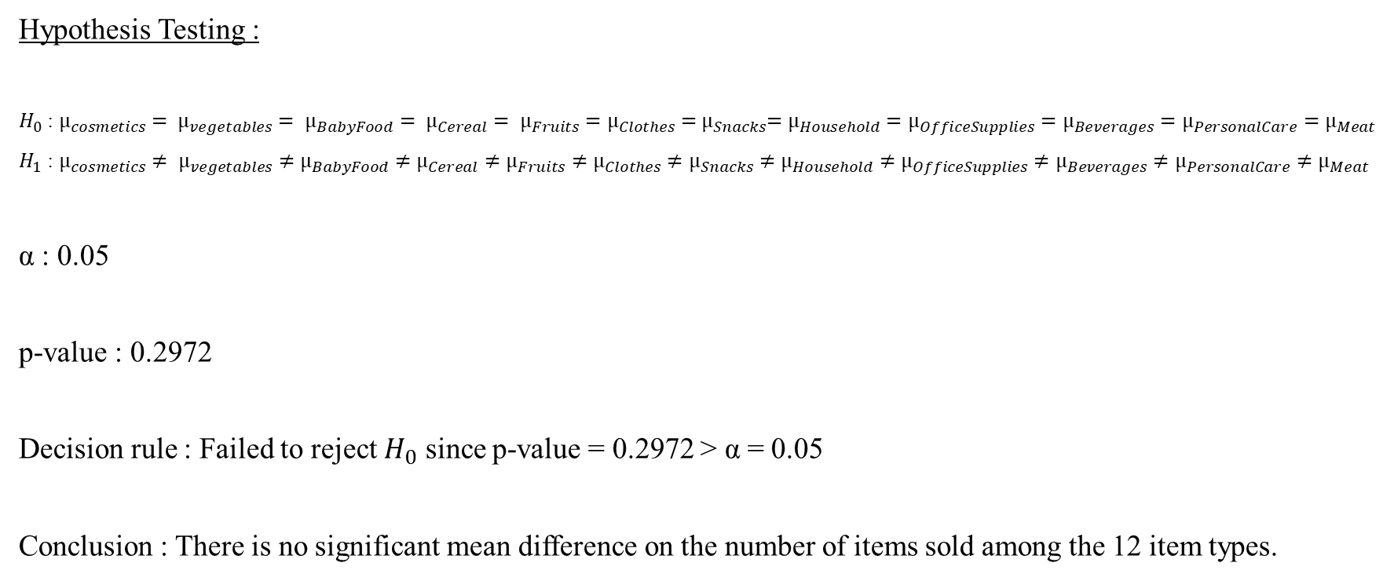
Inferential Statistic
Hypothesis Testing :
$H_{0}$ : $µ_{cosmetics}= µ_{vegetables}= µ_{BabyFood}= µ_{Cereal}= µ_{Fruits}=µ_{Clothes}={ µ}_{Snacks}=µ_{Household}=µ_{OfficeSupplies}=µ_{Beverages}=µ_{PersonalCare}=µ_{Meat}$
$H_{1}$ : $µ_{cosmetics}≠ µ_{vegetables}≠µ_{BabyFood}≠µ_{Cereal}≠µ_{Fruits}≠µ_{Clothes}≠µ_{Snacks}≠µ_{Household}≠µ_{OfficeSupplies}≠µ_{Beverages}≠µ_{PersonalCare}≠µ_{Meat}$
α : 0.05
p-value : 0.2972
Decision rule : Failed to reject $H_{0}$ since p-value = 0.2972 > α = 0.05
Conclusion : There is no significant mean difference on the number of items sold among the 12 item types.

Slide 34
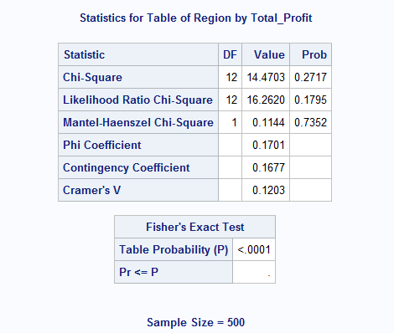
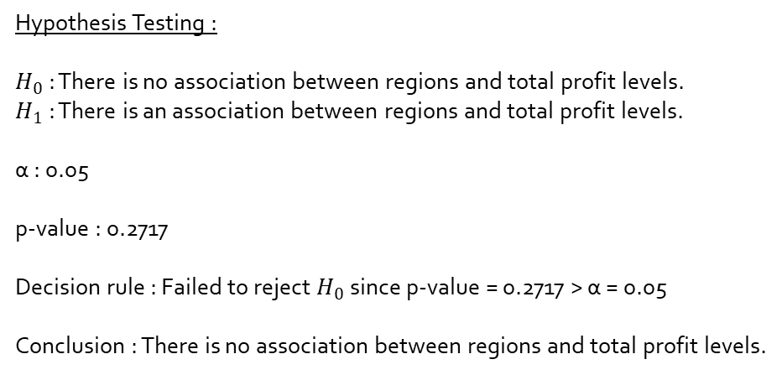
Chi-Square Test to Determine the Association Between Regions and Three Total Profit Levels
Inferential Statistic
proc freq data = project.regions;
tables region*total_profit / expected chisq fisher;
run;
Hypothesis Testing :
$H_{0}$ : There is no association between regions and total profit levels.
$H_{1}$ : There is an association between regions and total profit levels.
α : 0.05
p-value : 0.2717
Decision rule : Failed to reject $H_{0}$ since p-value = 0.2717 > α = 0.05
Conclusion : There is no association between regions and total profit levels.

Slide 35
CONCLUSION

Slide 36
Objective 1:
The total revenue for both Asia and Europe region does not follow a normal distribution and therefore, a non-parametric Man-Whitney U Test was used.
Both regions are very competitive in obtaining revenue from the items sold.
Objective 2:
A non-parametric test was also used to determine whether there is a significant difference in the number of items sold among different item types since there is no sufficient evidence to indicate that the data is normal.
The mean number of items sold by 12 different item types are the same.
Objective 3:
Chi-Square Test was used to observe the association between all regions and three total profit levels.
There is no obvious relationship between regions and the total profit obtained and hence, regions and total profit are independent to each other.

